Slide 1


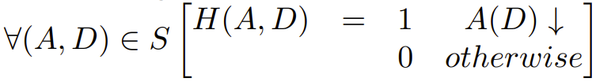





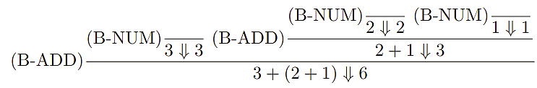
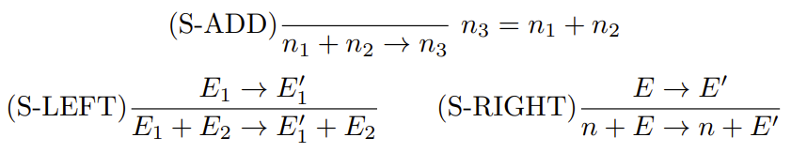




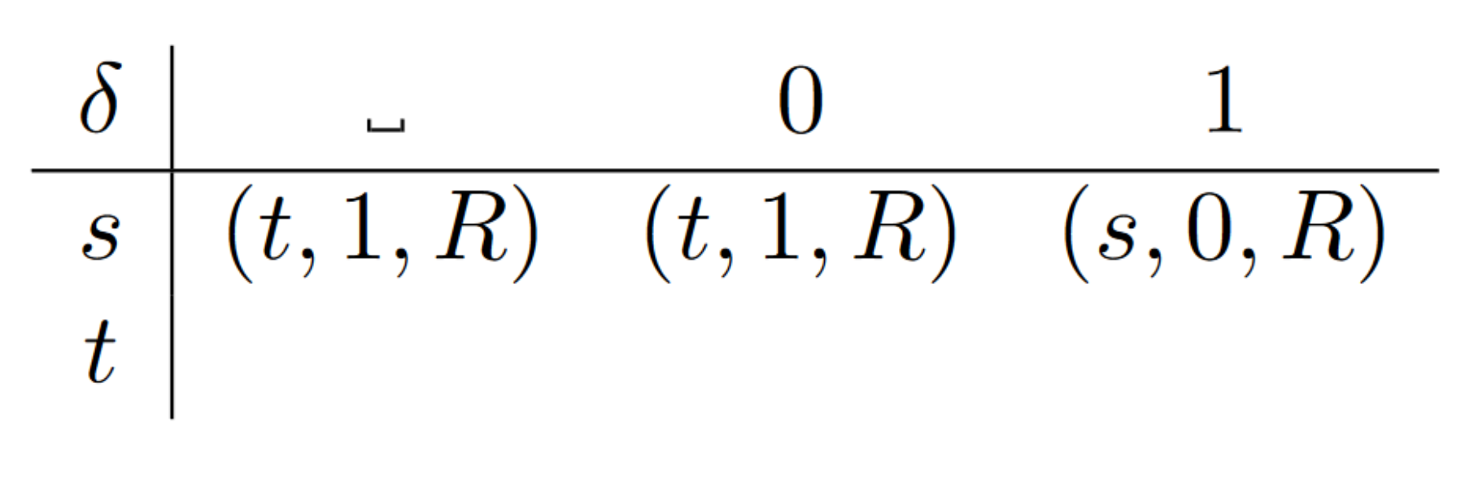


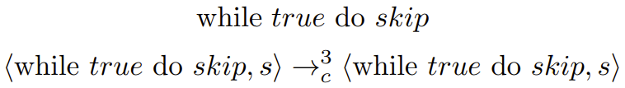





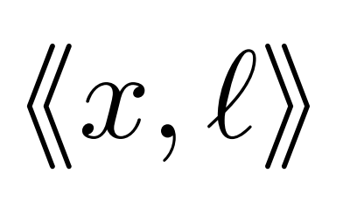
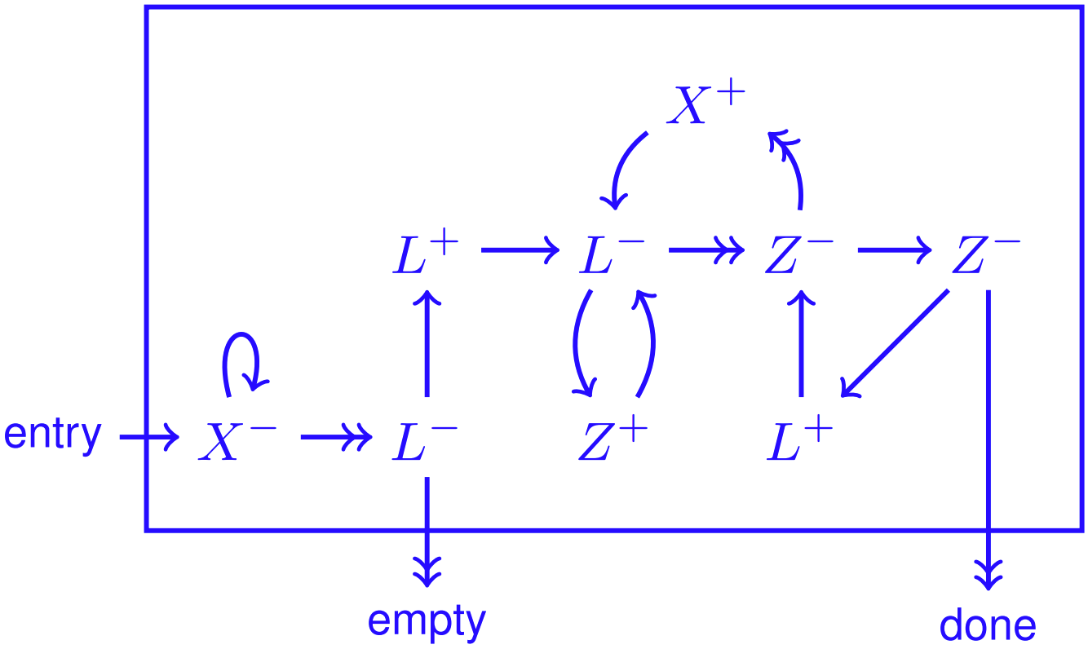






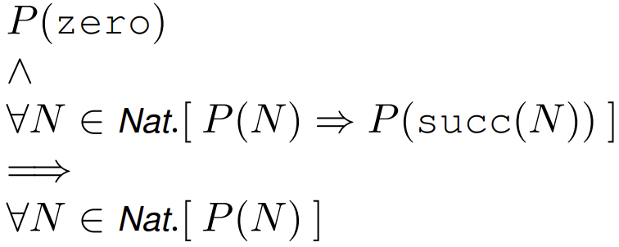
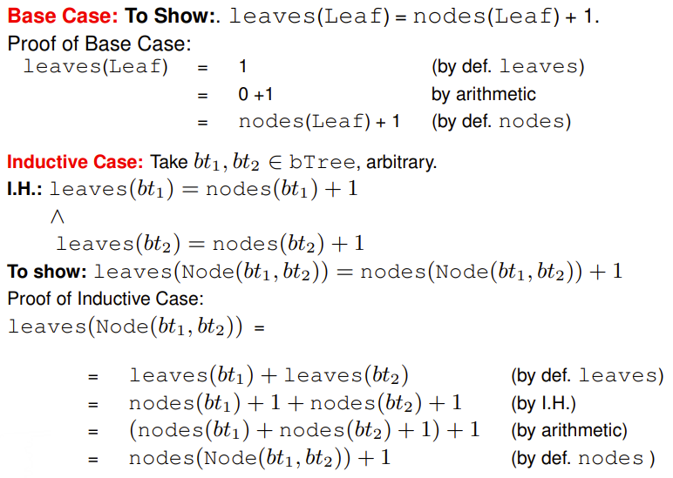
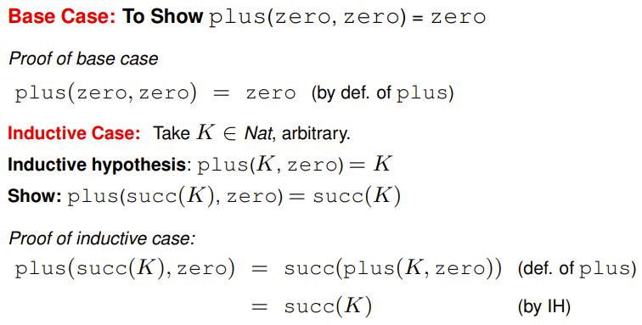
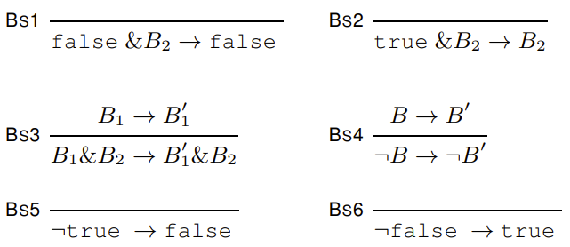
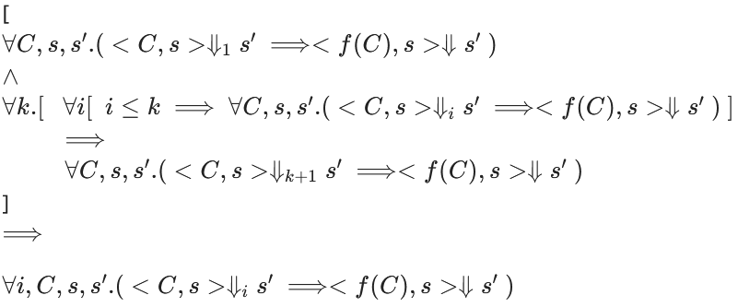
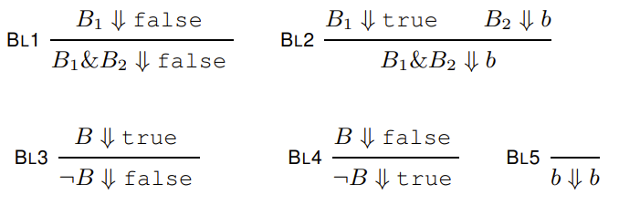
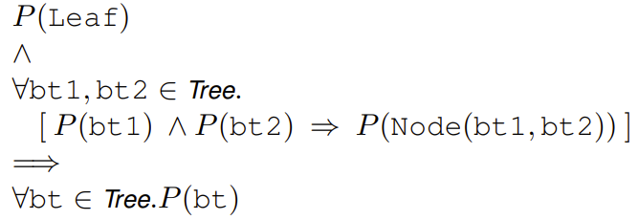
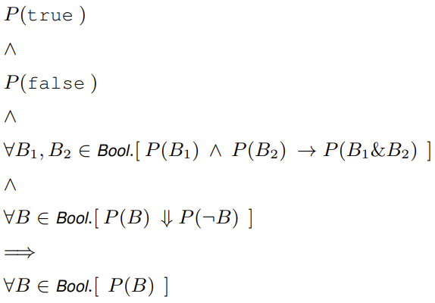
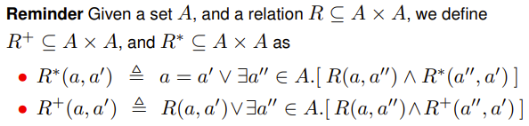
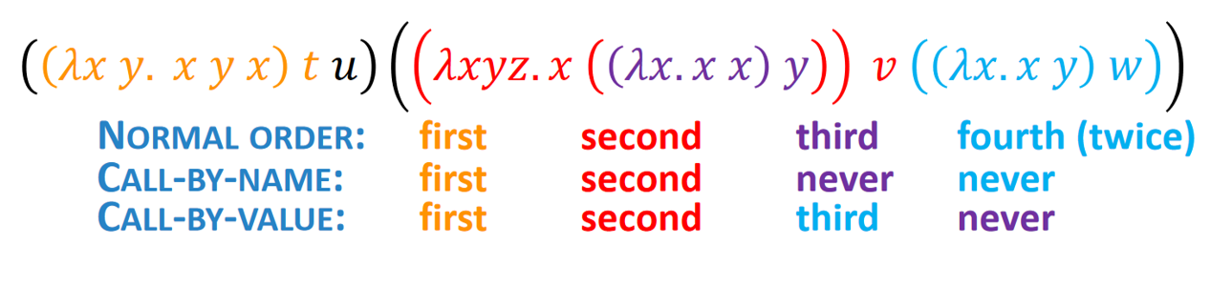


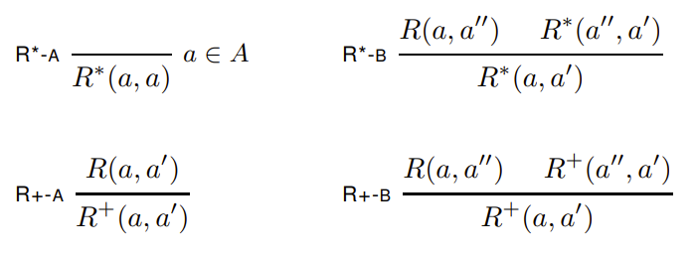

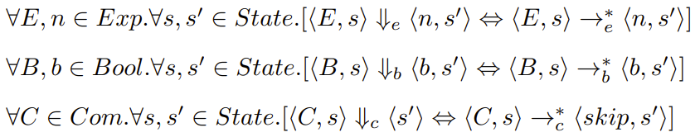
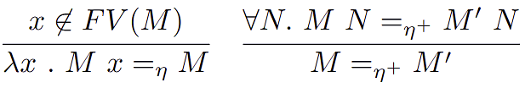
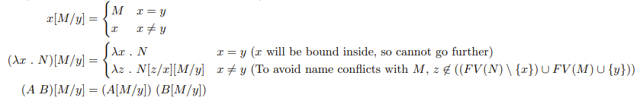
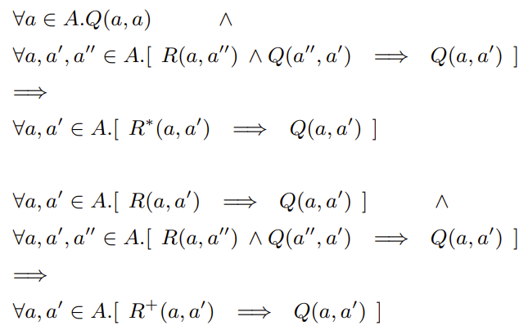
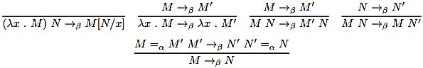
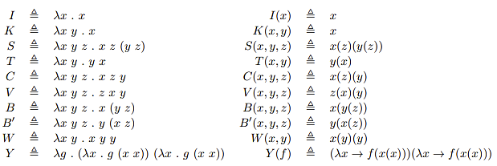

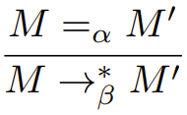
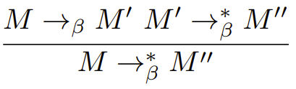


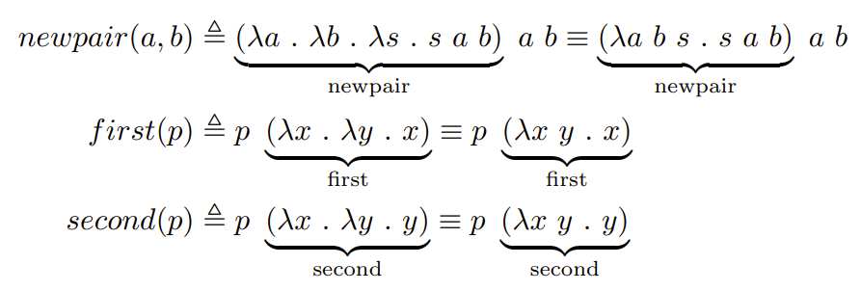
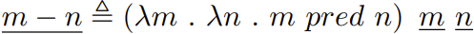
MoC
Finite: Description of the procedure in terms of elementary operations.
Deterministic: If there is a next step, it is uniquely determined - that is on the same data, the same steps will be made.
Denotational Semantics: a program’s meaning is described compositionally using mathematical objects (called denotations). A denotation of a program phase is built from denotations of its sub-phrases
Operational Semantics: a program’s meaning is given in terms of the steps of computation made when it runs
The Halting problem is a decision problem with:
- The set of all pairs (A, D) such that A is an algorithm and D is some input datum on which the algorithm operates
- The property A(D) ↓ holds for (A, D) ∈ S if an algorithm A when applied to D produces a result (halts)
Turing and Church showed that there is no algorithm such that:
The final step for Turing/Church’s proof was to construct an algorithm encoding instances (A, D) of the halting problem as statements such that:
Big-Step Semantics:
Ignores intermediate steps and gives result immediately:
Properties:
Determinacy: Expression evaluation is deterministic (only one result possible):
Totality: Every expression evaluates to something:
Example:
Rules:
Derivation:
Small-Step Semantics:
Evaluating an expression step-by-step:
Transitive closure :
Example rules: (note + is left-associative)
Adding this rule breaks determinacy (maintains confluence):
Normal Form (NF):
E is in it’s NF (irreducible) if there is no E’ such that
Properties:
Determinacy: There is at most one next possible step/rule to apply
Confluence: Determinate → Confluent. Several evaluation paths exist but all get the same end result
Strong Normalisation: All sequences of expressions are finite
Weak N.: There exists a finite sequence of expressions (to normalise) for any expression
Unique NF:
Specifying Turing Machines: TM to increment a “backwards” binary number:
Define M = (Q, Σ, s, δ)
where Σ = {␣, 0, 1},
Q = {s, t}, and δ:
Tracing their execution: remember state is (state, symbols to left of head, symbols on right)
Match state with first symbol on right to get cell for new state. E.g. (s, ε, 1001) →_{M} (s, 0, 001).
States:
A partial function from variables to numbers e.g.,
Small-step semantics of While are defined using configurations:
While allows statements with side-effects hence the state can be updated after an evaluation step.
is equivalent to:
Normalising:
and are normalising but bsb may not be, e.g.,
we have gone through +1 steps to get the same configuration, hence infinite loop
Gadget: Pop L to X. If L = 0, return X = 0 and go to “empty” else if L = <<x, = n then return X = n, L = l , goto “done”.
Properties: , , and are deterministic
and confluent
Configurations:
Answer: expression cannot be simplified further, e.g., the configuration as:
Stuck: when a configuration cannot be evaluated to a NF
Note a state which reduces to a stuck configuration is not stuck
Short-Circuit Semantics:
Note with side effects we can’t always short circuit as the RHS can cause side effects
Strictness:
An operation is strict when arguments must be evaluated before the operation. Addition is strict. Due to short circuiting, & is left strict as the operation can be evaluated without evaluating the right (non-strict in right argument).
Reminder: Induction over Nat +Tree
Boolean Semantics + Induction:
Small-Step:
Big-Step:
To Prove + Inductive Principle:
For Exp and Bool, we have proofs by induction on the structure of expressions/Booleans. For it is more complex as the direction cannot be proven using totality. Instead, complete/strong induction on the length of is used.
Lambda Calculus:
M ::= x (variable)
M ::= λx (abstraction)
M ::= MM (application, ((M) M) M)
Bound Variables:
λx . M → x is bound within the scope of M
Free Variables:
λx . M → y is free (unbound)
FreeVars (x) = {x}
FreeVars (λx . M) = FreeVars(M) \ {x}
FreeVars (M N) = FreeVars(M) ∪ FreeVars(N)
Closed Term:
λx y z . x y → λ-term with no free vars
Binding Occurrences:
λx y z . (…) → λ-term’s parameters (x, y, z)
Left Associativity:
A B C D ≡ (((A) (B)) (C)) (D)
α-Equivalence:
M =_{α} N iff N = M by renaming bound variables (free vs must have same name).
Substitution:
M[new/old] = replace free variable old with new in M
Reduction Order:
Normal: leftmost outermost redex first, always goes to NF
Call By Name: leftmost outermost first.
Call By Values: leftmost innermost redex first.
Transitive closures:
Defined through rules:
Inductive principles:
η-equivalence:
If the application of M to another λ-term is equivalent to M′ applied to the same λ-terms then M and M′ are equivalent.
λ-definable:
Partial function f : N^{n} ⇀ N is λ-definable iff there is a closed λ-term M where both hold:
f(x₁, ..., x_{n}) = y ⇔ M x₁ ... x_{n} =_{β} y
f(x₁, ..., x_{n})↑ ⇔ M x₁ ... x_{n} has no normal form
Semantics:
A term of the form λx . N M bbbbbbbbbbbbbbbbbbbbbbbbbbbbbbbbbbbbbbbbbbbbbbbbbbbbbbbbbbbbis called a redex. A λ-term bbbbbbbbbbbbbbbbbbbbbbbbbbbbbbbbbbbbbbbbbbbbbbbbbbbbbbbbbbbbmay have several different bbbbbbbbbbbbbbbbbbbbbbbbbbbbbbbbbbbbbbbbbbbbbbbbbbbbbbbbbbbbreductions which form a bbbbbbbbbbbbbbbbbbbbbbbbbbbbbbbbbbbbbbbbbbbbbbbbbbbbbbbbbbbbderivation tree.
Multi-Step Reductions: Steps can be combined using the transitive closure of →_{β} under α-conversion:
Reflexivity of α-conversion: Transitivity:
Confluence: All derivation paths in the tree that reach some NF reach the same NF:
∀M, M₁, M₂. [M →_{β}* M₁ ∧ M →_{β}* M₂ ⇒ ∃M′.[M₁ →_{β}* M′ ∧ M₂ →_{β}* M′]]
β Normal Forms: The λ-term contains no redexes (can’t be further reduced). If an NF exists it is unique.
is in normal form(M) ≜ ∀N. M /→_{β} N
has a normal form(M) ≜ ∃M′ . M →_{β}* M′ ∧ is in normal form(M’)
β-equivalence: M =_{β} N ⇔ ∃T. [M →_{β}* T ∧ N →_{β}* T]
Combinators: Closed λ-term (no free vars)
Church Numerals:

Slide 2
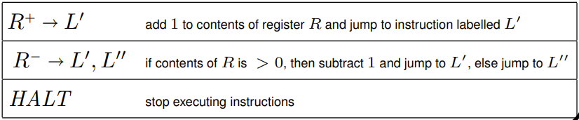
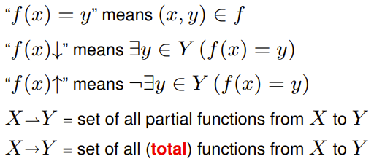
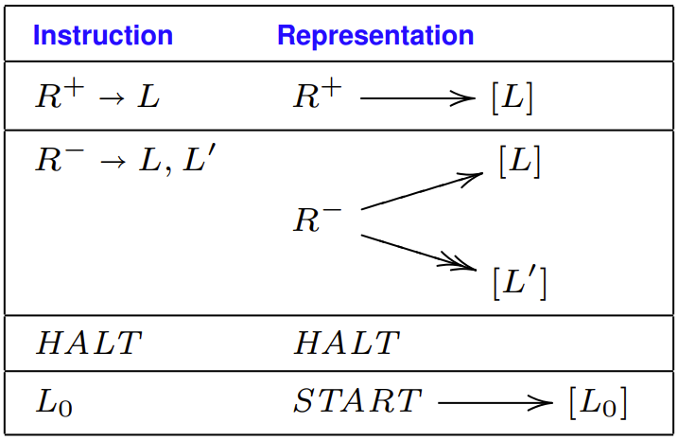
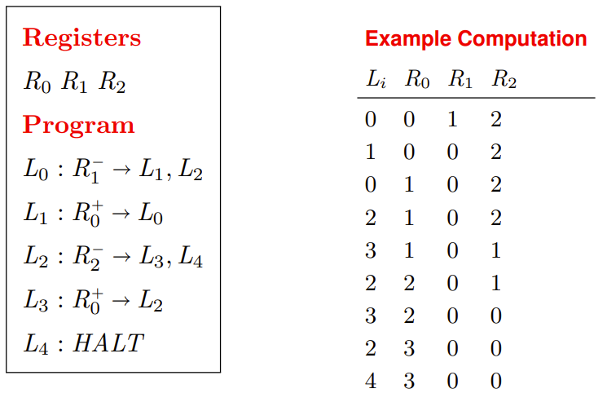





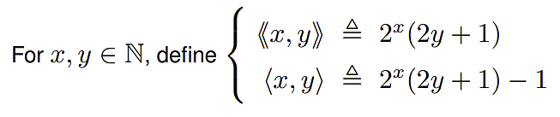
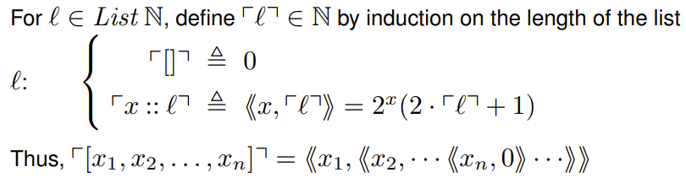
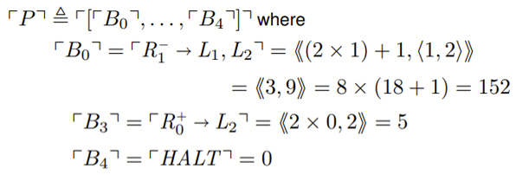
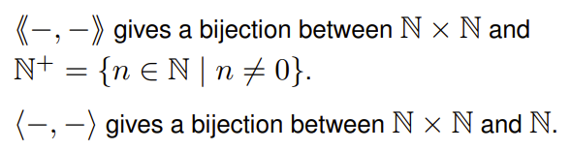

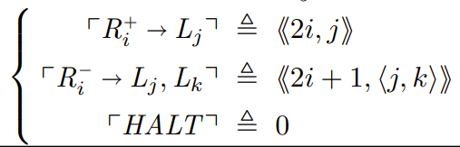
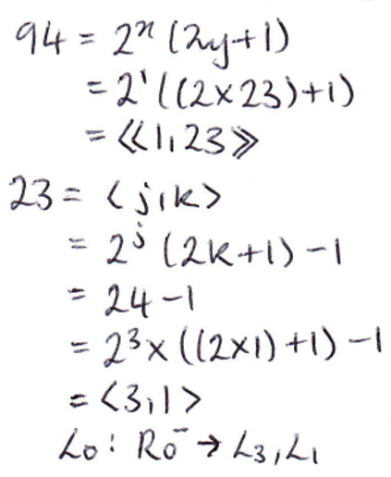
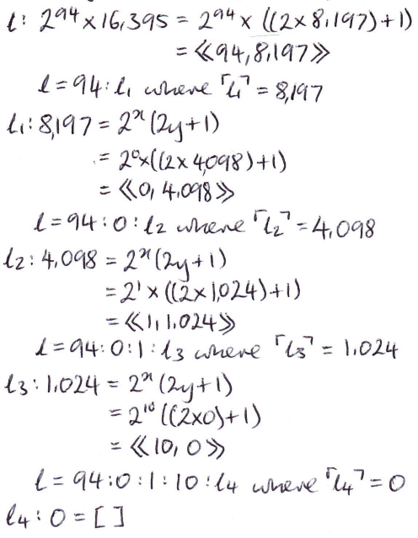
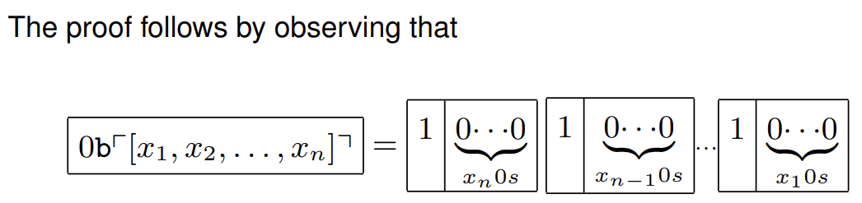
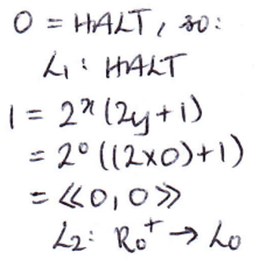
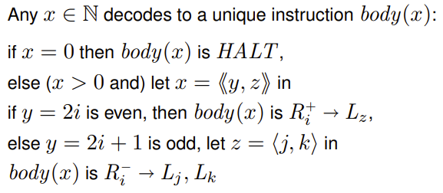
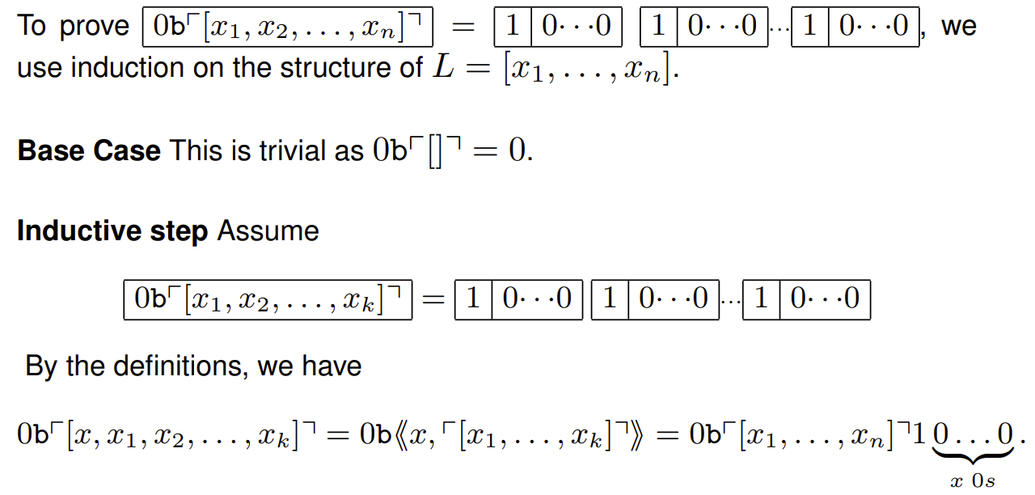
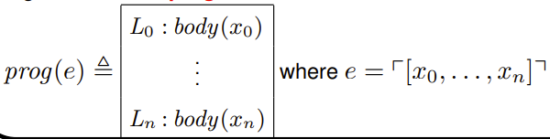
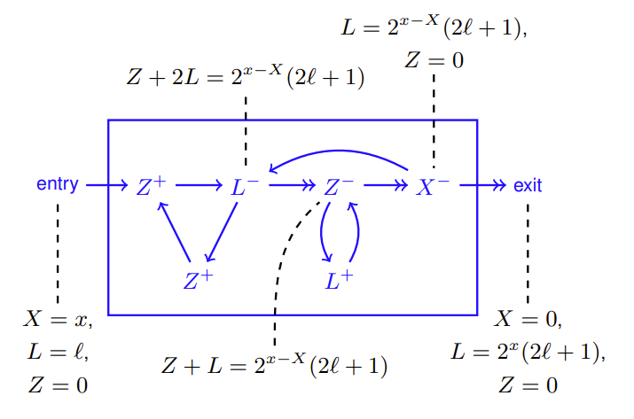

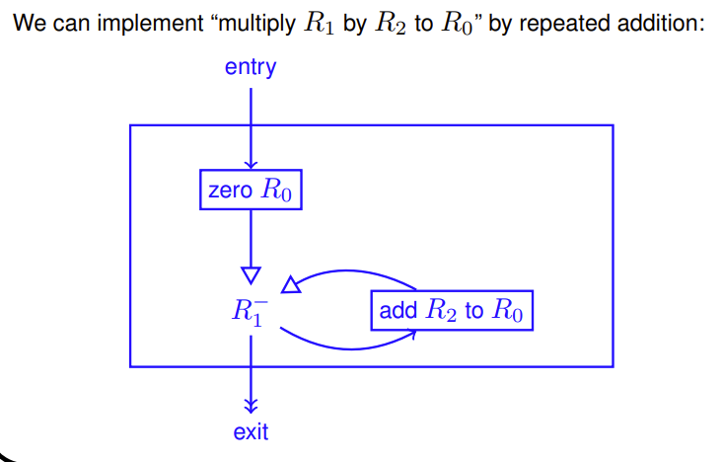
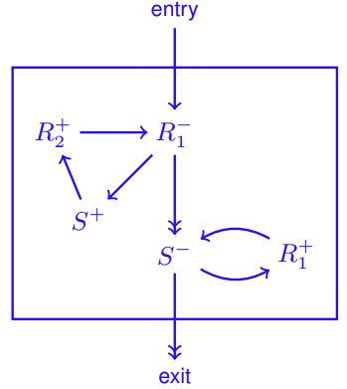
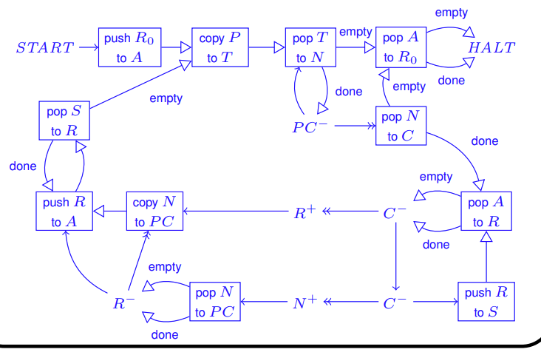




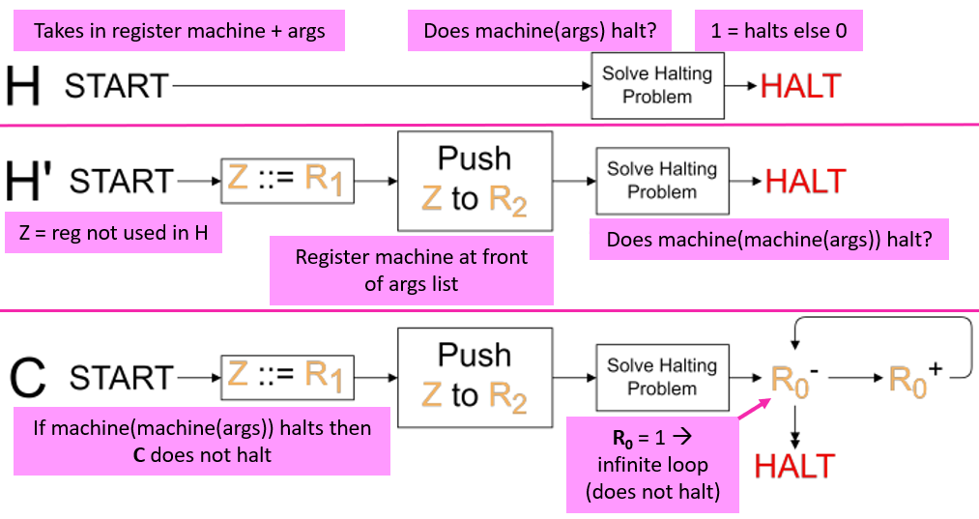
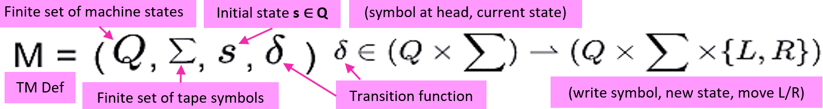






Register machines:
A RM is specified by:
- Finitely many registers (R₀, R₁, … R_{n}) each capable of storing a natural number
- A program consisting of a finite list of instructions of the form label:body where, for i = 0, 1, 2, …, the (i + 1)^{th} instruction has label L_{i}. The instruction body takes the form:
Configurations:
A configuration has the form c = (l, r₀, …, r_{n}), where l = current label and r_{i} = current contents of R_{i}. The initial configuration
c₀ = (0, r₀, …, r_{n}) starts at label 0 and contains the initial contents of each register.
R_{i} = x [in configuration c] means c = (l, r₀, …, r_{n}) with r_{i} = x.
Computation:
A computation of an RM is a (finite or infinite) sequence of configurations c₀, c₁, …, c_{n} with each c = (l, r₀, …, r_{n}) in the sequence determining the next configuration by carrying out the instruction L_{l} with registers containing r₀, …, r_{n}.
Partial Functions:
Register machine computation is deterministic – in any non-halting configuration, the next configuration is uniquely determined by the program. The relation between initial and final register contents defined by a register machine program is a partial function.
Properties:
Graphical Representation:
Halting:
Two ways to halt:
1. Jump to instruction L_{x} where L_{x} : HALT
2. Jump to an undefined instruction (“erroneous halt”)
Never halts:
L₀ : R₁⁺ → L₀
A partial function from a set X to a set Y is total if it satisfies ddddjfor all
Example computation from initial configuration (0, 0, 1, 2):
Example function:
The partial function is (register machine) computable if there is a register machine M with at least n + 1 registers R₀, R₁, …, R_{n} (and maybe more) such that for all dddd and all , the computation of M starting with
R₀ = 0, R₁ = x₁, …, R_{n} = x_{n}
and all registers set to 0, halts with R₀ = y iff f(x₁, …, x_{n}) = y.
Numerical Coding of Pairs:
Example Decoding Instructions:
Numerical Coding of Lists:
Numerical Coding of Programs:
If P is the RM program
L₀ : body₀, L₁ : body₁, …, L_{n} : body_{n}:
where the numerical code of the body is:
Example encoding:
Example decoding:
Decoding programs:
Gadgets:
A gadget is a partial register-machine graph. It has one entry wire, and one or more exit
The decoded program e is unique, where
wires. The gadget operates on input and output registers specified in the gadget’s name. The gadget
may use scratch registers for temporary storage. The gadget assumes the scratch registers are initially set to 0, and must ensure that they are set back to 0 when the gadget exits.
R₁ + R₂
R₀ = R₁ * R₂
Reasoning about Invariants
Universal Register Machine:
A register machine which simulates another register machine. It takes arguments R₀ = 0, R₁ = encoded program no. R₂ = encoded arg. list, R_{3…n} = 0.
Register usage: R₁ = Prog, R₂ = Args, R₃ = PC, R₄ = Next label/current instr, R₅ = Current instr, R₆ = Reg val for current instr, R₇ + R₈ = Auxiliary regs (S + T), R_{9…n} = Scratch regs.
Gadget: Push X to L
Restores R₁
Steps in URM:
1. Copy PCth item of list in P to N (halting if PC > length of list)
2. If N = 0 then halt, else decode N bbas (C = y, N = z)
3. Copy i^{th} item of list in A to R
4. Execute current instruction on R; bbupdate PC to next label;
bbrestore register values to A; bbrepeat
Halting Problem for Register Machines:
A register machine H decides the halting problem if for all e, a₁, …, a_{n} N:
bbbR₀ = 0, R₁ = e, R₂ = , R_{3…n} = 0
And where H halts with the state as follows:
1 Register machine encoded as e halts when started with R₀ = 0, R₁ = a₁, . . . , R_{n} = a_{n}
R₀
0 Otherwise
We can prove that there is no such machine H through a contradiction.
Turing Machines:
C(C) halts → C with R₁ = ⌜C⌝ as an argument does not halt
C(C) does not halt → Then C with R₁ = ⌜C⌝ as an argument halts
Both contradictions
Transition Function as Table:
Transition:
(q, w, u) →_{M} (q’, w’, u’)
TM = RM:
Theorem: The computation of a TM M can be impl by an RM.
Proof: 1. Fix a numerical encoding of M’s states, symbols, contents, and configs. 2. Impl M’s transition functions (finite table) using RM instrs on codes. 3. Impl a RM program to repeatedly carry out →_{M}.
No entry = undefined = HALT
Enumerating Computable Functions:
For each e ∈ N, let ϕ_{e} ∈ N ⇀ N be the unary partial function computed by the RM with program prog(e). So, for all x, y ∈ N, ϕ_{e}(x) = y holds iff the computation of prog(e) started with R₀ = 0, R₁ = x, and all other registers 0, and eventually halts with R₀ = y. Thus e ϕ_{e} defines an onto function from N to the collection of all computable partial functions from N to N.
Uncomputable Functions:
Let f ∈ N⇀N be the partial function {(x, 0) | ϕ_{x}(x)↑}. Thus:
0 if ϕ_{x}(x)↑ f is not computable, because if it were then f = ϕ_{e} for some e ∈ N
f(x) hence if ϕ_{e}(e)↑, then f(e) = 0 so ϕ_{e}(e) = 0, i.e. ϕ_{e}(e)↓
undefined if ϕ_{x}(x)↓ if ϕ_{e}(e)↓, then f(e)↑ so ϕ_{e}(e)↑ Contradiction!
Undecidable Sets of Numbers:
Given a subset S ⊆ N, its characteristic function χ_{S} ∈ N → N is
1 if x ∈ S
χ_{S}(x) ≜ S ⊆ N is RM decidable if χ_{S} is RM computable.
0 if x ∉ S
S₀ ≜ {e | ϕ_{e}(0)↓} is undecidable, because if such an RM exists to solve it, the Halting Problem would be solved. Hence this is a contradiction so the set is undecidable.
S₁ ≜ {e | ϕ_{e}(0) total function} is undecidable, because if an RM existed to compute χ_{S1} we can create another RM checking membership of S₀ hence undecidable.
TF as Mealy Machine:
First and Last: ∑* → ∑ x ∑*
These split off the first/last symbols of a string (splitting off ␣ if the string is empty)
Configuration:
(q, w, u) where
q = current state (q ∈ Q),
w = finite string of symbols left
of head, u = right, and w, u ∈ ∑*
Start State:
(s, ɛ̝, u) initial state, no symbols to the left, input to right
Normal Form:
(q, w, u) where δ(q, a)↑ is undefined for first(u) = (a, u’)
Turing Computability:
f ∈ N^{n} ⇀ N is TC iff there is TM M s.t.:
Starting M from init state with head on leftmost 0 of tape coding
[x1, ..., xn], M halts iff f(x1, . . . , xn)↓, and the final tape codes a list (length ≥ 1) with first elem y where
f(x1, . . . , xn) = y.
Coding a List of Numbers:
A tape over Σ = {␣, 0, 1} codes a list of numbers if it looks like:
Which corresponds to the list [n₁, n₂, …, n_{k}]
Note the ␣s between the 1s

